Slide 1

Diploma Studies
Computer Engineering
Basic Computer Organization and Design
Unit – 2
Title - Basic Computer Organization and Design
Computer Organization (09CE2401)

Slide 2
What is Program ?

Slide 3
What is Program
Program is a set of instruction that specify the operations operands, and the sequence by which processing has to occur.
Computer Instruction, Computer instructions are a set of machine language instructions that a particular processor understands and executes. A computer performs tasks on the basis of the instruction provided.

Slide 4
Instruction Code
Instruction Code:- is a group of bits that instructs computer to perform specific operation. (in binary)
Operations (opcode) such as addition, subtraction, shift, complement, etc.
An instruction must also include one or more operands, which indicate the registers and/or memory addresses from which data is taken or to which data is deposited.

Slide 5
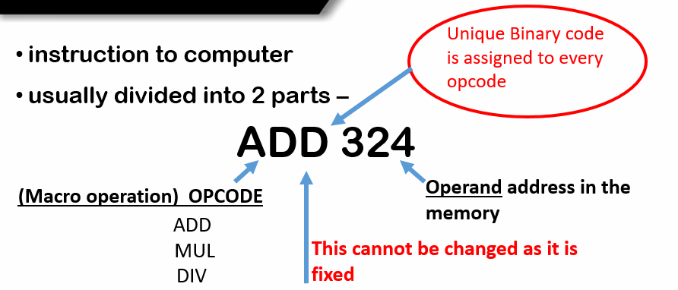
Instruction code

Slide 6
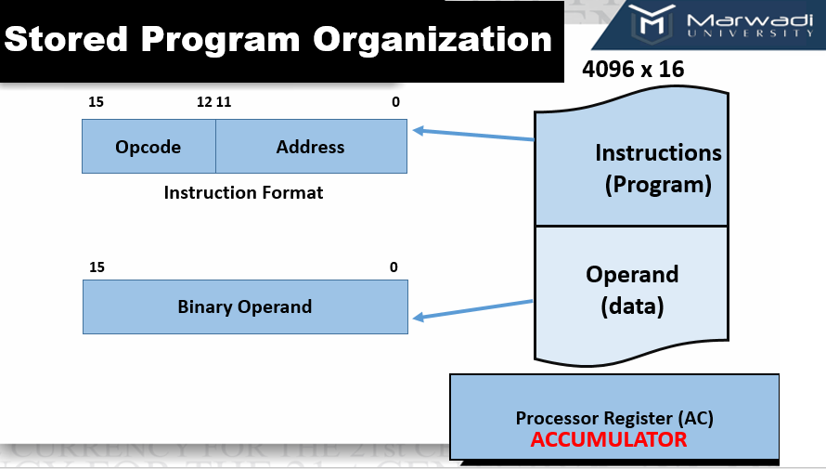
Memory contains 4096 words of 16 bit each, to address 4096 location
we will require 2 raise to 12 address.

Slide 7
Stored Program Organization
The simplest way to organize a computer is to have one processor register and an instruction code format with two parts.
The first part specifies the operation to be performed and the second specifies an address.
The memory address tells the control where to find an operand in memory.
This operand is read from memory and used as the data to be operated on together with the data stored in the processor register.

Slide 8
Stored Program Organization
Instructions are stored in one section of memory and data in another.
For a memory unit with 4096 words we need 12 bits to specify an address since 2¹² = 4096.
If we store each instruction code in one 16-bit memory word, we have available four bits for the operation code (abbreviated opcode) to specify one out of 16 possible operations, and 12 bits to specify the address of an operand.
The control reads a 16-bit instruction from the program portion of memory.
It uses the 12-bit address part of the instruction to read a 16-bit operand from the data portion of memory. It then executes the operation specified by the operation code.

Slide 9
Computer Instructions
Computer Instruction:-
Computer instructions are a set of machine language instructions that a particular processor understands and executes. A computer performs tasks on the basis of the instruction provided.
An instruction comprises of groups called fields. These fields include:
The Operation code (Opcode) field which specifies the operation to be performed.
The Address field which contains the location of the operand, i.e., register or memory location.
The Mode field which specifies how the operand will be located.

Slide 10
Computer Instructions
A basic computer has three instruction code formats which are:
Memory - reference instruction
Register - reference instruction
Input-Output instruction

Slide 11
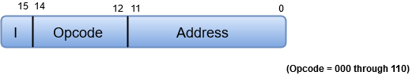
(1) Memory Reference Instruction
In Memory-reference instruction, 12 bits of memory is used to specify an address and one bit to specify the addressing mode 'I'.
If the value of I is 0, it means direct addressing and value of I is 1 indicates indirect addressing.
Opcode values are between 000 and 110 (i.e., 0-7).
0-6 represents different Operations(opcode)

Slide 12

Direct Addressing Mode
In direct addressing mode, the address field in the instruction contains the effective address of the operand and no intermediate memory access is required.
Nowadays it is rarely used.
Example: Add the content of R1 and 1001 and store back to R1:
Add R1, (1001)
Here 1001 is the address where the operand is stored.

Slide 13
Indirect Addressing Mode
In Indirect addressing mode, the address field in the instruction contains the memory location or register where the effective address of the operand is present.
It requires two memory access.
It is further classified into two categories: Register Indirect, and Memory Indirect.
Example:
LOAD R1, @500
The above instruction is used to load the content of the memory location stored at memory location 500 to register R1.
In other words, we can say, effective address is stored at memory location 500.

Slide 14
(1) Memory Reference Instruction
D₀ = 000 (AND OPERATION)
Example:- AND to AC
D₀ T₄: DR <- M[AR]
D₀ T₅: AC <- AC ^ DR, SC <- 0
D₁ = 001 (ADD OPERATION)
Example:- ADD to AC
D₁ T₄: DR <- M[AR]
D₁ T₅: AC <- AC + DR, SC <- 0
E <- Count
E = contains Carry, called Extended Accumulator
AC = Accumulator
DR = Data Register
AR = Address Register
SC = Sequence Counter

Slide 15
(1) Memory Reference Instruction
D₂ = 010 (LOAD OPERATION)
Example:- LDA to AC
D₂ T₄: DR <- M[AR]
D₂ T₅: AC <- DR, SC <- 0
D₃ = 011 (STORE OPERATION)
Example:- STA to AC
D₃ T₄: M[AR] <- AC, SC <- 0

Slide 16
(1) Memory Reference Instruction
D₄ = 100 (Branch Unconditionally)
Example:- Branch Unconditionally
D₄ T₄: PC <- AR, SC <- 0
D₅ = 101 (Branch & Save Return Address)
Example:- BSA
D₅ T₄: M[AR] <- PC, AR <- AR+1
D₅ T₄: PC <-AR, SC <- 0
D₆ = 110 (Increment & skip if zero)
Example:- ISZ
D₆ T₄: DR <- M[AR]
D₆ T₅: DR <- DR+1, M[AR] <- DR ,
if (DR=0), PC <- PC+1, SC <- 0

Slide 17

(2) Register Reference Instruction
These instructions perform operations on registers rather than memory addresses.
The IR(14 – 12) is 111 (differentiates it from memory reference) and IR(15) is 0 (differentiates it from input/output instructions).
The rest 12 bits specify register operation.

Slide 18
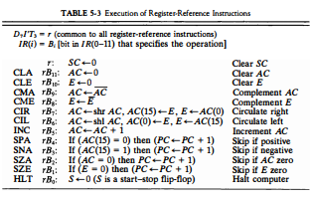
(2) Register Reference Instruction
D₇I’T₃ = r (common to all register-reference instruction)
IR(i) =Bi (Bits in IR (0-11) that specifies the operation

Slide 19

(3) Input-Output instruction
These instructions are for communication between computer and outside environment.
The IR(14 – 12) is 111 (differentiates it from memory reference) and IR(15) is 1 (differentiates it from register reference instructions).
The rest 12 bits specify I/O operation.

Slide 20
Computer Instructions
Note:-
The three operation code bits in positions 12 through 14 should be equal to 111.
Otherwise, the instruction is a memory-reference type, and the bit in position 15 is taken as the addressing mode I.
When the three operation code bits are equal to 111, control unit inspects the bit in position 15. If the bit is 0, the instruction is a register-reference type.
Otherwise, the instruction is an input-output type having bit 1 at position 15.

Slide 21
Timing and Control
The timing for all registers in the basic computer is controlled by a master clock generator.
The clock pulses are applied to all flip-flops and registers in the system, including the flip-flops and registers in the control unit.

Slide 22
Timing and Control
The clock pulses do not change the state of a register unless the register is enabled by a control signal.
The control signals are generated in the control unit and provide control inputs for the multiplexers in the common bus, control inputs in processor registers, and micro-operations for the accumulator.

Slide 23
Design of Control Unit
The Control Unit is classified into two major categories:
Hardwired Control
Microprogrammed Control

Slide 24
Control Unit
Hardwired Control
The Hardwired Control organization involves the control logic to be implemented with gates, flip-flops, decoders, and other digital circuits.

Slide 25
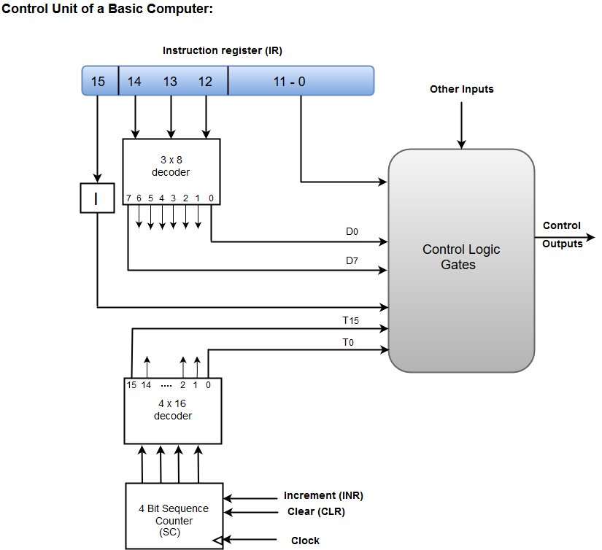
Control Unit – Hardwired Control

Slide 26
Control Unit – Hardwired Control
A Hard-wired Control consists of two decoders, a sequence counter, and a number of logic gates.
An instruction fetched from the memory unit is placed in the instruction register (IR).
The component of an instruction register includes; I bit, the operation code, and bits 0 through 11.
The operation code in bits 12 through 14 are coded with a 3 x 8 decoder.

Slide 27
Control Unit – Hardwired Control (Continue)
The outputs of the decoder are designated by the symbols D0 through D7.
The operation code at bit 15 is transferred to a flip-flop designated by the symbol I.
The operation codes from Bits 0 through 11 are applied to the control logic gates.
The Sequence counter (SC) can count in binary from 0 through 15.

Slide 28
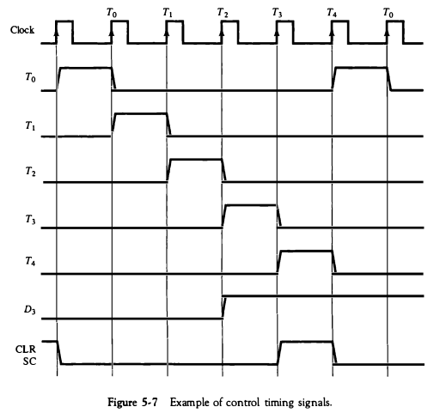
Control Unit – Hardwired Control Example
Example:-
As an example, consider the case where SC is incremented to provide timing signals T0, T1, T2, T3, and T4 in sequence. At time T4, SC is cleared to 0 if decoder output D3 is active. This is expressed symbolically by the statement (D3T4: SC <-0)

Slide 29
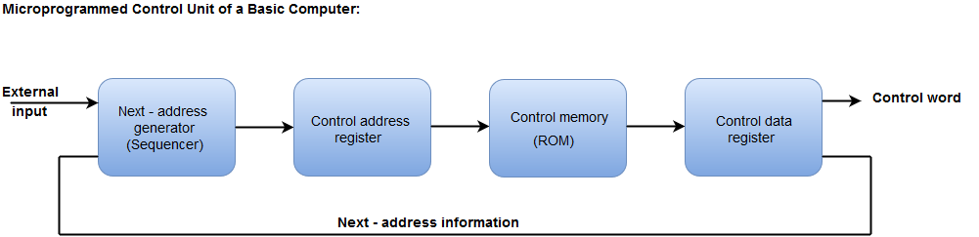
(2) Control Unit – Microprogrammed Control
The Microprogrammed Control organization is implemented by using the programming approach.
In Microprogrammed Control, the micro-operations are performed by executing a program consisting of micro-instructions.
The following image shows the block diagram of a Microprogrammed Control organization.

Slide 30
(2) Control Unit – Microprogrammed Control
The Control address register specifies the address of the micro-instruction.
The Control memory is assumed to be a ROM, within which all control information is permanently stored.
The control register holds the micro-instruction fetched from the memory.
The micro-instruction contains a control word that specifies one or more micro-operations for the data processor.

Slide 31
(2) Control Unit – Microprogrammed Control (Continue)
While the micro-operations are being executed, the next address is computed in the next address generator circuit and then transferred into the control address register to read the next microinstruction.
The next address generator is often referred to as a micro-program sequencer, as it determines the address sequence that is read from control memory.

Slide 32
Instruction Cycle
A program residing in the memory unit of a computer consists of a sequence of instructions.
These instructions are executed by the processor
1. Fetch an instruction from memory
2. Decode the instruction
3. Read the effective address from memory if the instruction has an indirect address
4. Execute the instruction
After the following four procedures are done, the control switches back to the first step and repeats the similar process for the next instruction. Therefore, the cycle continues until a Halt condition is met.

Slide 33
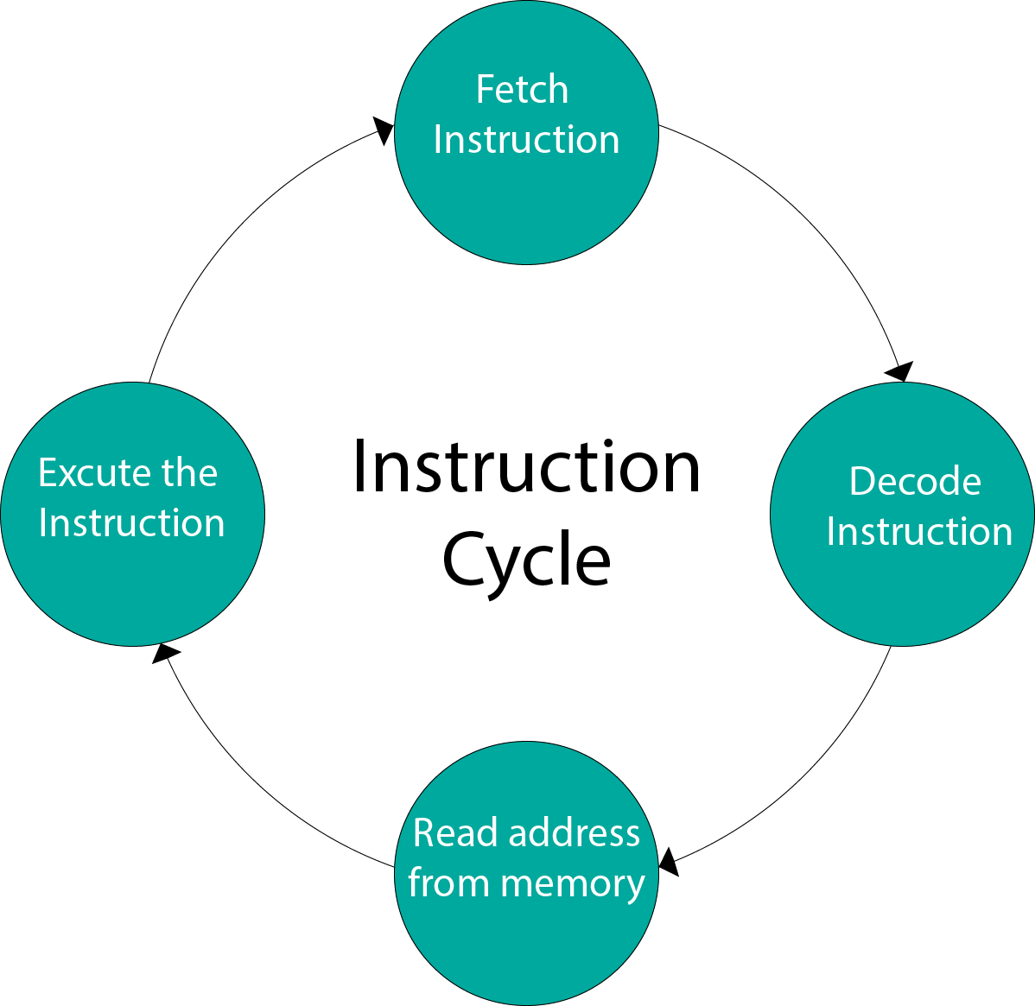
Instruction Cycle – Diagram 1

Slide 34
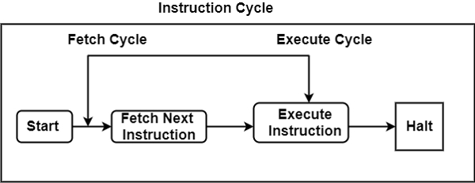
Instruction Cycle – Diagram 2

Slide 35
Instruction Cycle
(1) Fetch Cycle
The address instruction to be implemented is held at the program counter.
The processor fetches the instruction from the memory that is pointed by the PC.
Next, the PC is incremented to display the address of the next instruction.
This instruction is loaded onto the instruction register. The processor reads the instruction and executes the important procedures

Slide 36
Instruction Cycle
(2) Execute Cycle
The data transfer for implementation takes place in two methods are as follows −
(i) Processor-memory − The data sent from the processor to memory or from memory to processor.
(ii) Processor-Input/Output − The data can be transferred to or from a peripheral device by the transfer between a processor and an I/O device.

Slide 37
INTERRUPT

Slide 38
Interrupt
The interrupt is a signal emitted by hardware or software when a process or an event needs immediate attention.
It alerts the processor to a high-priority process requiring interruption of the current working process.
In I/O devices one of the bus control lines is dedicated for this purpose and is called the Interrupt Service Routine (ISR).

Slide 39
Interrupt
When a device raises an interrupt at the process, the processor first completes the execution of an instruction.
Then it loads the Program Counter (PC) with the address of the first instruction of the ISR.
Before loading the program counter with the address, the address of the interrupted instruction is moved to a temporary location.
Therefore, after handling the interrupt, the processor can continue with the process.

Slide 40
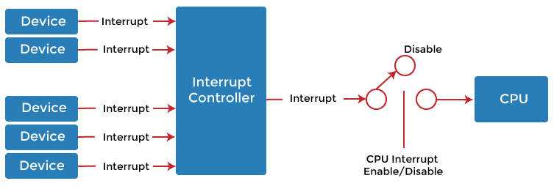
Interrupt

Slide 41
Types of Interrupt
There are two types of interrupts which are as follows :
Hardware Interrupt
Software Interrupt

Slide 42
Types of Interrupt
There are two types of interrupts which are as follows :
Hardware Interrupt
Software Interrupt
INTERRUPT
HARDWARE INTERRUPT
SOFTWARE INTERRUPT
MASKABLE INTERRUPT
NON-MASKABLE INTERRUPT
NORMAL INTERRUPT
EXECPTION

Slide 43
Types of Interrupt
Hardware Interrupt:-
The interrupt signal generated from external devices and i/o devices are made interrupt to CPU when the instructions are ready.
For example- In a keyboard if we press a key to do some action this pressing of the keyboard generates a signal that is given to the processor to do action, such interrupts are called hardware interrupts.

Slide 44
Types of Interrupt
Hardware interrupts are classified into two types which are as follows −
(i) Maskable Interrupt − The hardware interrupts that can be delayed when a highest priority interrupt has occurred to the processor.
(ii) Non Maskable Interrupt − The hardware that cannot be delayed and immediately be serviced by the processor.

Slide 45
Types of Interrupt
(2) Software Interrupt:-
The interrupt signal generated from internal devices and software programs need to access any system call then software interrupts are present.
Software interrupt is divided into two types. They are as follows-
(i) Normal Interrupts- The interrupts that are caused by the software instructions are called normal interrupts.
(ii) Exception- Exception is nothing but an unplanned interruption while executing a program. For example − while executing a program if we got a value that is divided by zero is called an exception.

Slide 46
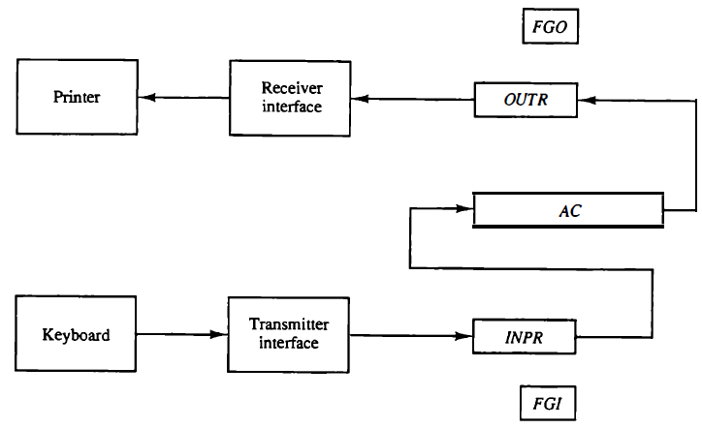
Input-Output Configuration
1 bit control flag
1 bit control flag

Slide 47
Input-Output Configuration
The figure displays an illustration of the input and output device.
The input device is the keyboard and the output device is the printer.
The terminals are the keyboard and printer.
They send and receive the data consecutively.
The data is alphanumeric and 8-bits in size.
The input supported by the keyboard is transfer to the input register INPR.
The information is saved in the OUTPR (output register) in the serial order for the printer.
The OUTR saves the serial data for the printer.

Slide 48
Input-Output Configuration
The I/O registers communicate serially with interfaces (keyboard, printer) and parallel with AC.
The sender interface receives data from the keyboard and transfers it to INPR.
The receiver interfaces access the data and address it to the printer.
The INPR holds the 8- bit alphanumeric input data.

Slide 49
Input-Output Configuration
FGI defines a 1-bit input flag which is a flip-flop.
When the input device receives any new information, the flip flop is set to 1.
It is cleared to 0 when information is received through the output device.
The output device sets the FGO to 1 after receiving, decoding, and printing the information.
FGO in the 0 modes denotes that the device is printing information.

Slide 50


